Slide 1


Simulation Meeting:
Samoa Cyclone
Preparedness and Emergency Response
Geneva, 16 November 2011
David Leng

Slide 2
Samoa
.
Set the Scene

Slide 3
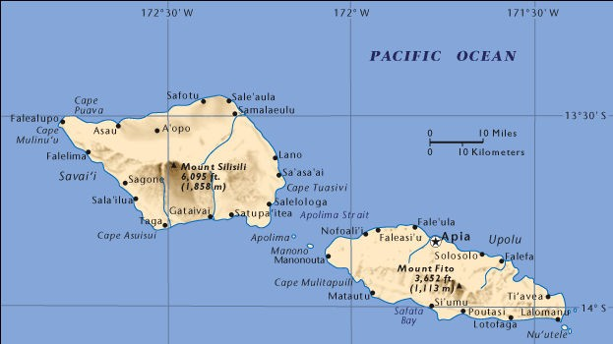
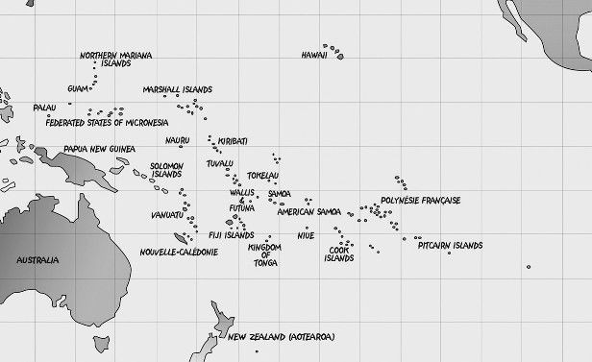
Location
I
3700 km (~5hrs)
2900 km (~4hrs)

Slide 4
Samoa
.
Background
Popn ~185,000 in country
120,000+ overseas
35% urban, 70% Upolu, 30% Savaii
330 Villages, 43 Districts
Land Area 1934 sq km

Slide 5
Samoa
.
Background
Roading: Good, Complete ring
Electricity Cover: ~95%
Mobile Phone Coverage:~90%
Mobile Usage:~65%
Popn: 90% coastal

Slide 6
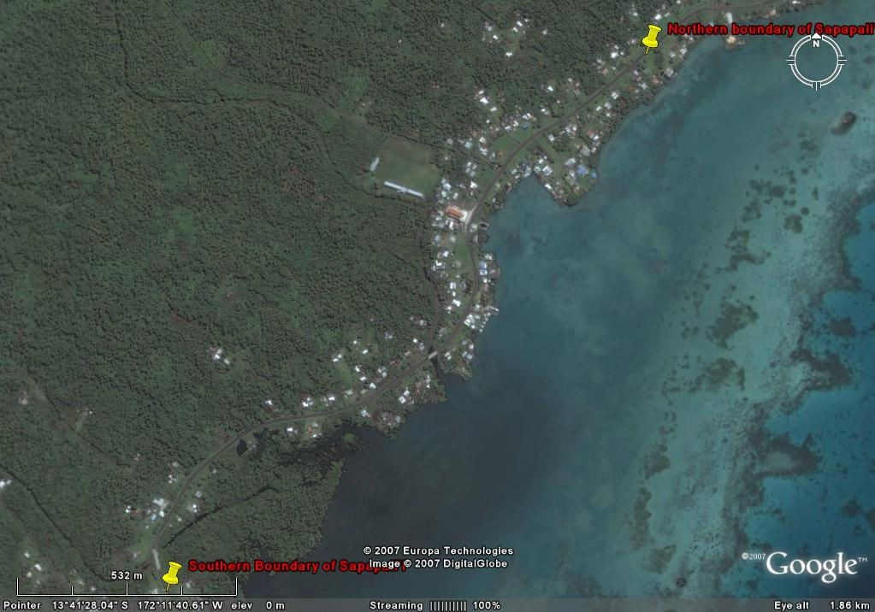
Samoa
.
Background
Popn: 90% coastal
35% Urban
~65% live off land (Agrarian)

Slide 7
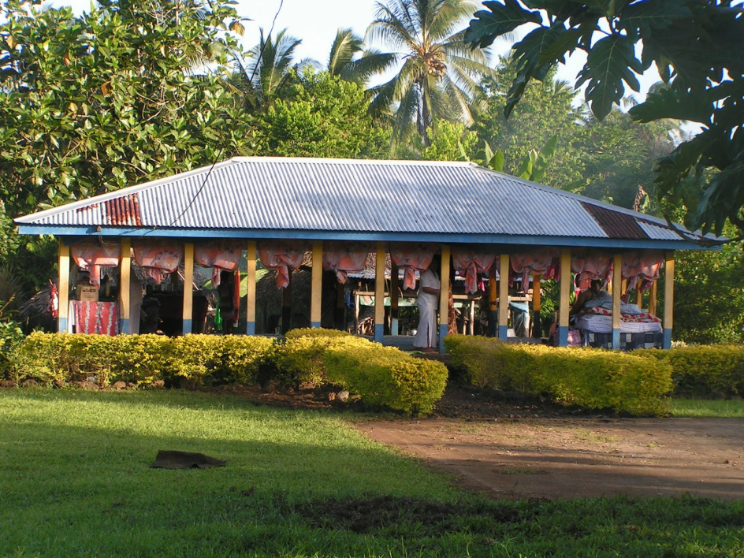
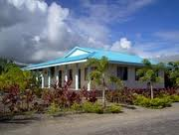
Samoa
.
Background

Slide 8
Samoa
.
Medical
Hospitals :2 Main (Surgical )
6 Rural (6 Bed, No Surgical)
13 Light Medical Clinics
50 Doctors
700 Nurses
1 Medical University (100+ Students

Slide 9
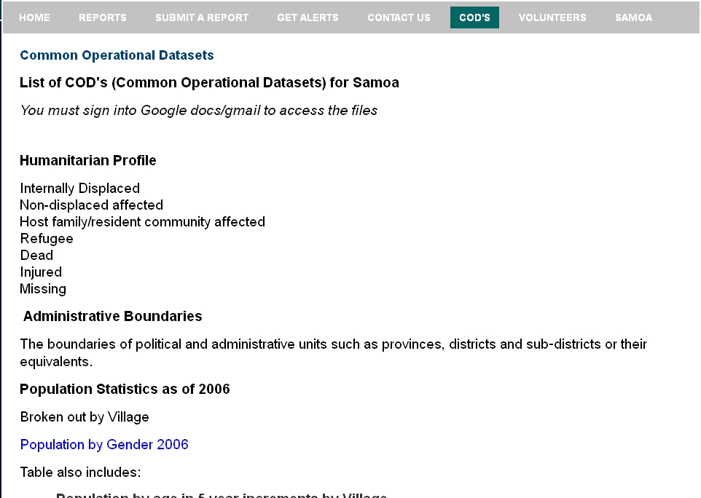
Samoa
.

Slide 10
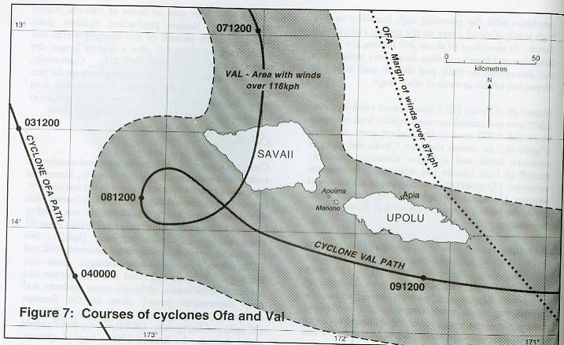
Simulation

Slide 11
Simulation
Stats
4 Days
Sustained Winds ~120kph
At times up to 260kph (160+ mph) (110+dB)
Storm Surge ~50 Foot waves
Flooding
Landslides

Slide 12
Impacts
4 days
was described as looking like an atomic bomb had hit
"there was no green, no buildings standing, no shelter; just total and complete devastation”.

Slide 13
Impacts
4 days
90% Crop loss
90% Foliage cover
50% Stock Loss
65% Building damage (80% housing loss)
Fishing: - Reef destruction,
Ocean – 20% Boat loss
Medical – 50% facility loss
30% Supplies loss
Roading Coastal Road damage
Assessed damages and loss 230% GDP

Slide 14
Operational
On Ground
Local Disaster Management Office
Fire and Emergency
OCHA
Red Cross
ADRA
Ministries

Slide 15
Operational
Tools
Vanilla Ushahidi on server
Google docs COD’s
Want to add sms capability to alerts

Slide 16
Operational
Virtual
Humanity Road – generating field requests
SBTF – generating reports
Gdacs – simulated storm surge, wind, path
Imaging?

